Slide 1
SALARY SURVEY ANALYSIS
ARUN BALAJE
DA & DS AUG B

Slide 2
DESCRIPTION :
The Dataset consists 28060 Rows and 14 Columns
Age Range, Industry, Job Title, Annual Salary, Additional Monetary Compensation, Currency, Country, State, City, Years of Professional Experience Overall, Years of Professional Experience in Field, Highest Level of Education Completed, Gender etc.,

Slide 3
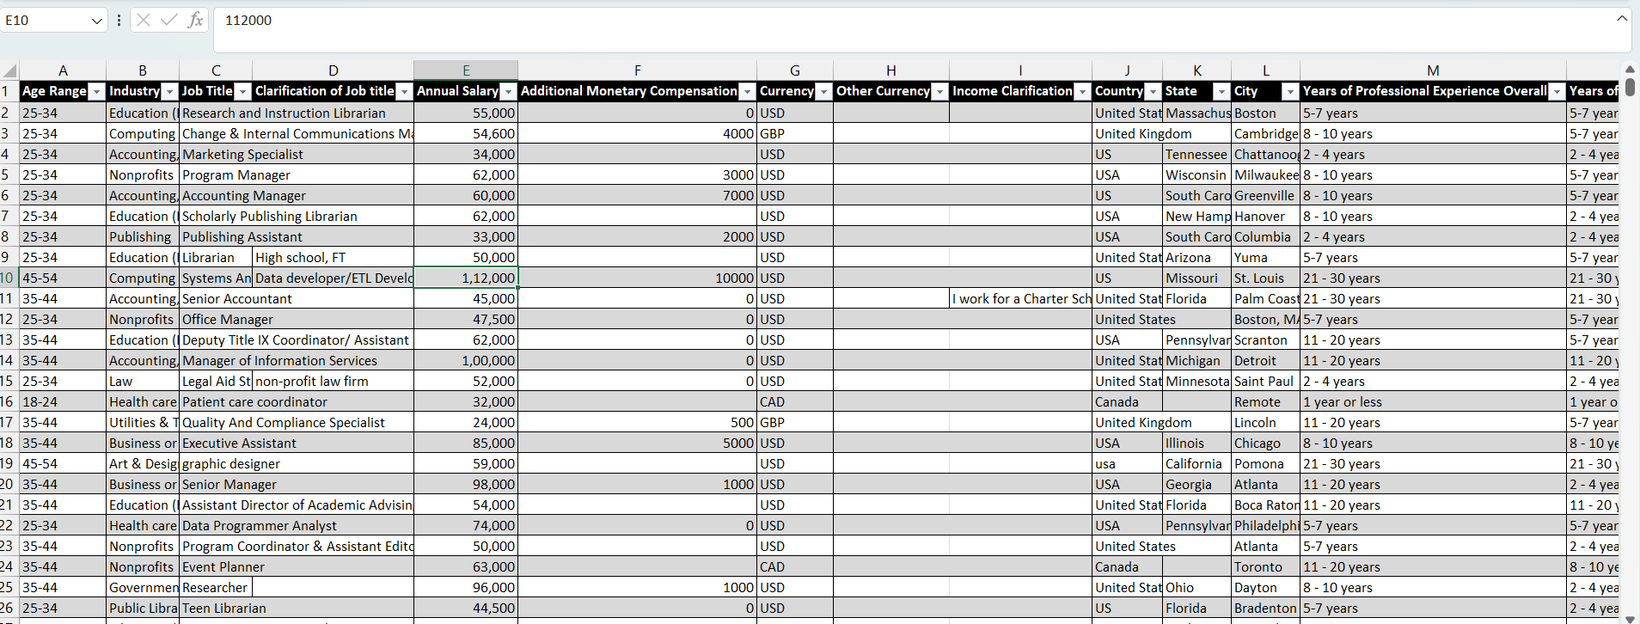
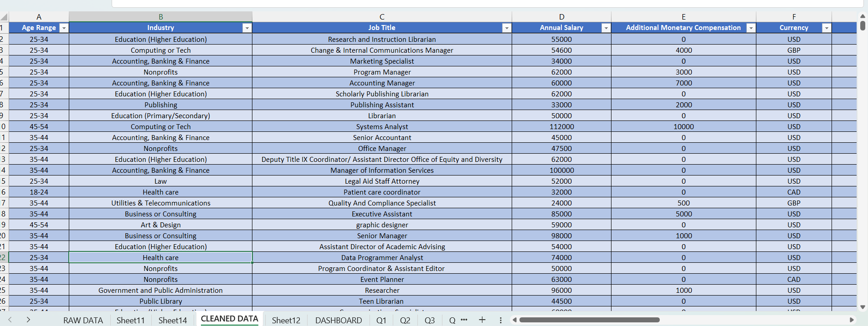
Data Cleaning:
By Removing Blank values and Duplicate values.
Standardized categorical data like Industry, Jobtitle, Country, state.
Raw Data
Cleaned Data

Slide 4
SQL Database Creation:
Average Salary by Industry & Gender.
Salary by Compensation & Job title.
Salary by Highest level of Education.
Employees by Industry, Experience overall & Field Experience.
Salary by Job, Country.
Country by Job, Avg Salary.
Avg Salary by City & Industry.
Gender by Compensation.
Total Compensation by Job, , Experience overall & Field Experience.
Avg Salary by Industry, Gender & Highest level of Education.

Slide 5
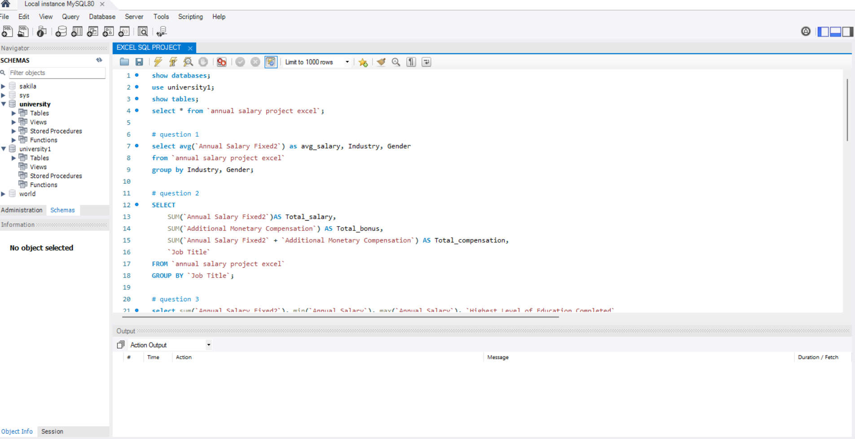
MySQL Work Bench:
In SQL Workbench the queries are written to a new create a data board creation to view multiple factors.

Slide 6
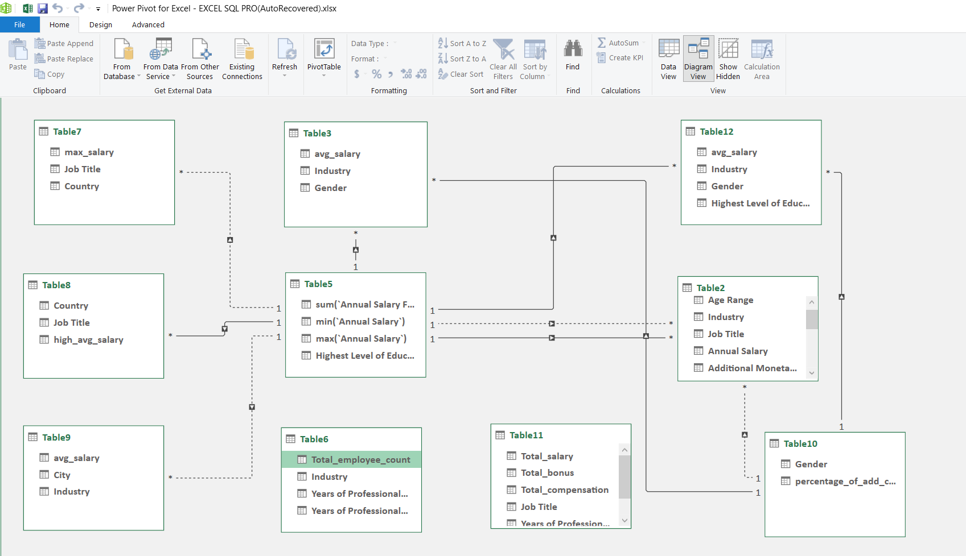
Power Pivot:

Slide 7
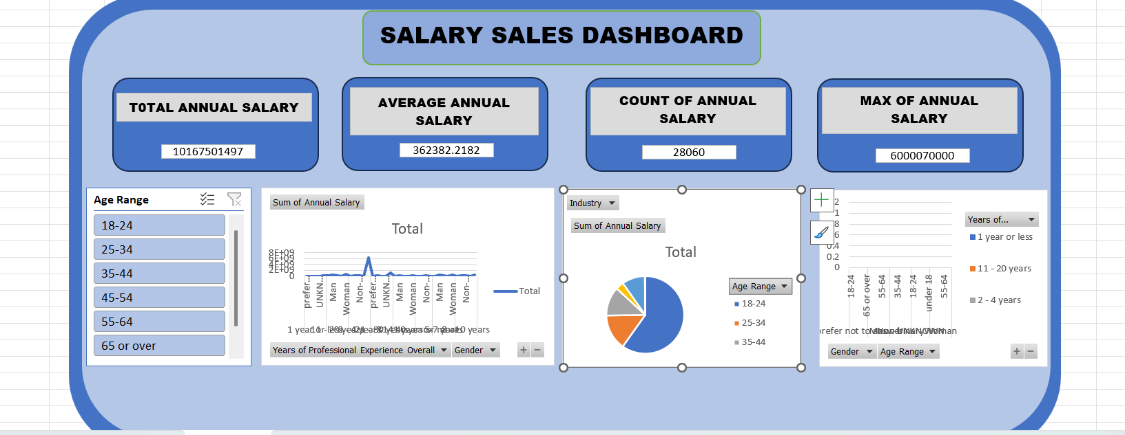
Dash Board:

Slide 8
Insights:
IT sector field is the top paying in overall.
Employees other than Non-IT filed are less paying but have higher experience.
USA placed top paying country.
Employees having higher education have low average salary.
Average Men salary is lower than women.

Slide 9
Conclusion:
The analysis helps to understand the salary based on countries.
Employees having higher education have less salary compare to the basic education.
Experience , Education, Professional Experience in Field plays a role in salary.

